Slide 1



Call center voice clustering
Indira college of engineering and management
Guide: Manisha Bharati
Rohan Salvi 24140
Shubham Asabe 24250
Sanket Shirse 24239
Vipul Ahire 24245

Slide 2
Problem Statement
To evaluate Customer Request To Service Call Center in Text Format for classify the Request into different categories;
New vehicle purchase
Test drive requests
Breakdown
Feedback
Insurance

Slide 3
Aim
Currently, call center agents interact with customers and try to facilitate and fulfill the customer needs. As part of the solution, we need to classify the customer Request in Text Format To Service Call Center into different categories of Request linked with automotive industry (i.e., new vehicle purchase enquiries, test drive request, breakdown assistance, roadside assistance, Insurance, Servicing etc.) for necessary action by the business.
We need to Customer Request in Text Format To Service Call Center for classify the Request into different categories listed below:
1. New vehicle purchase enquiries ( i.e., Enquiry on latest or future or existing product features, price, availability, closest showroom to drop in for purchase or exchange, etc.)
2. Test drive requests ( i.e., Request for booking test drives, follow up Request with customers to schedule the same, confirmation that test drive has been done as per schedule or with delayed schedule, etc.)
3. Breakdown ( i.e., Customer Send Request TO contact center to report vehicle break down and providing his location details for repair or breakdown assistance, Road assistance mechanic reaching out to customer and reaching location with preliminary input on vehicle condition )
4. Feedback ( Feedback collected post sales /service on vehicle delivery on customer sales/ service experience)

Slide 4
objectives
Objectives 40-50 %
1.GUI User End Module
2.Database connection module -Record Store in DB module
3.OTP verify module
4.Login Authentication module
5.Voice to input module
6.Extract token from Sentence module
7.Special Symbol remove module
8.Remove stop words, Keep keywords module
(conclusion: Data ready for further process)
Remaining
1.Detecting the keywords which department they belong.
2.apply machine learning on updating stop words.
3.The data bank of specific department words will also generate and add new words on the basis of machine learning to its data bank.
4.Output of every user relating to the specific department will be shown on admin portal.
5. and can be downloaded in csv format. Frontend Analytics

Slide 5
Motivation
In today's world , many customer send request to call center there is a lot of waiting for thousands of people at a time ,to make this quick and efficient we are going to work on this project
This was the problem statement given by TCS in their hackathon.

Slide 6
Literature survey
Sr no.​ | Paper Title​ | Idea/Algorithm description​ | Problem found​
​1 | Multiclass Digital Audio Segmentation with MFCC​ Features using Naive Bayes and SVM Classifiers(2019)(ASYU)​ | ​Detects Silence, Speech and Music | Detects only audio segments​
2 | Analysis of Detected Silent Segments in Call​ Center Recordings(2019)(IDAP)​ | Adaptive amplitude Threshold, Entropy and variance, RNN​ | Solution for audio processing​
3​ | Feature Selection for Anomaly Detection in Call Center Data(2019) (ELECO)​ | O-SVM, IF and a MG​ | Did not cluster the data
4​ | Text clustering algorithm based on deep​ representation learning(2018 )(The Journal of Engineering)​ | K-means, VSM (TF-TDF),CNN)​ | Did not deal with audio data set​
5​ | Artificial Neural Networks in Customer Segmentation(2019)(SIU)​ | MLP​​ | More into visualization, Don’t deal with audio data​​
Notes:
Support Vector Machine/
Mel Frequency Cepstral Coefficients feature extraction
Isolation forests Multivariate Gaussian
multilayer perceptron

Slide 7
Literature survey
Sr no.​ | Paper Title​ | Idea/Algorithm description​ | Problem found​
​6 | Mobile Phone Clustering From Speech Recordings Using Deep Representation and Spectral Clustering(2018) | MFCC,SVM
7 | A Hybrid Approach for Mobile Phone Clustering With Speech Recordings(2019) | MFCCs, MPC | Speech recording over mobile phones
8 | Machine Learning-based Silence Detection in Call Center Telephone Conversations(2019) | Naive Bayes, MFCC, K means
9 | Classification Techniques for Automatic Speech Recognition (ASR) Algorithms used with Real Time Speech Translation(2017) | DTW,MFCC,HMM | Works on small dataset
10 | A Review on Emotion Recognition using Speech(2017) | MFCC,RNN,KNN,LPCC | Rises problem with Different size of audio
Notes:
Probabilistic yin
Support Vector Machine/
Mel Frequency Cepstral Coefficients feature extraction
Isolation forests Multivariate Gaussian
multilayer perceptron

Slide 8
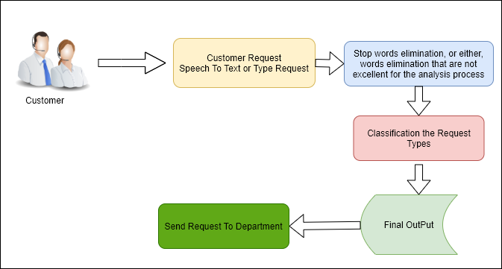
Pre-Processing Approach

Slide 9
Tools and technology used
Java
JDK
XAMPP
JDK
APACHE
MYSQL
OPERATING SYSTEM | WINDOWS XP/7/10
Development Framework | Java Framework 1.8 JDK
Programming Language | Java 8.1
Database | MySQL 5.5
IDE | Eclipse

Slide 10
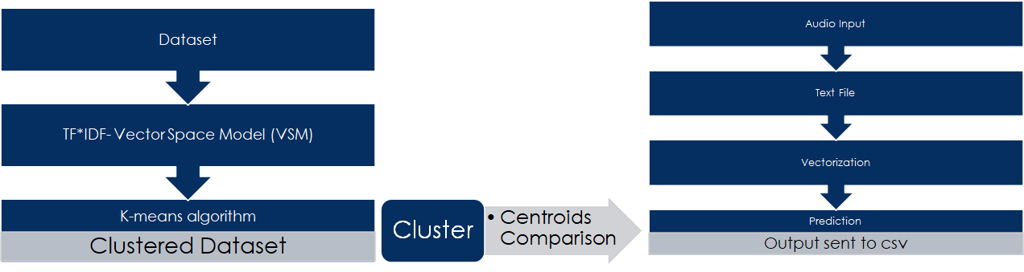
System architecture

Slide 11
AlgorithmS
TF*IDF
K-means

Slide 12
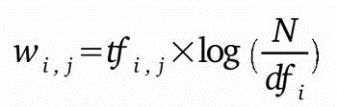
TF-IDF
Term frequency-inverse document frequency also called tf-idf, is a well-known method to evaluate how important is a word in a document. tf-idf are also a very interesting way to convert the textual representation of information into a Vector Space Model (VSM).
TF*IDF is an information retrieval technique that weighs a term’s frequency (TF) and its inverse document frequency (IDF). Each word or term has its respective TF and IDF score. The product of the TF and IDF scores of a term is called the TF*IDF weight of that term. We have to create vectorizer using Tf-idf Vectorizer class to fit and transform the document which we have created.
Notes:
This is done by multiplying two metrics:
Tf no. of occurrence of I in j
Df bumber of documents in
- Easy to compute - You have some basic metric to extract the most descriptive terms in a document - You can easily compute the similarity between 2 documents using it
TF-IDF is based on the bag-of-words (BoW) model, therefore it does not capture position in text, semantics, co-occurrences in different documents, etc

Slide 13
K-means
K-Means algorithm is an iterative algorithm that tries to partition the dataset into K pre-defined distinct non
overlapping subgroups (clusters) where each data point belongs to only one group. It tries to make the intra
cluster data points as similar as possible while also keeping the clusters as different (far) as possible. It assigns data
points to a cluster such that the sum of the squared distance between the data points and the cluster’s centroid
(arithmetic mean of all the data points that belong to that cluster) is at the minimum. The less variation we have
within clusters, the more homogeneous (similar) the data points are within the same cluster.
The value of K defines the Number of clusters that is the 5 categories we are choosing. More number of clusters = more numbers of divisions
Advantages of K-Means:
Widely used method for cluster analysis
Easy to understand

Slide 14
DFD Level 0
System
Input
Output

Slide 15
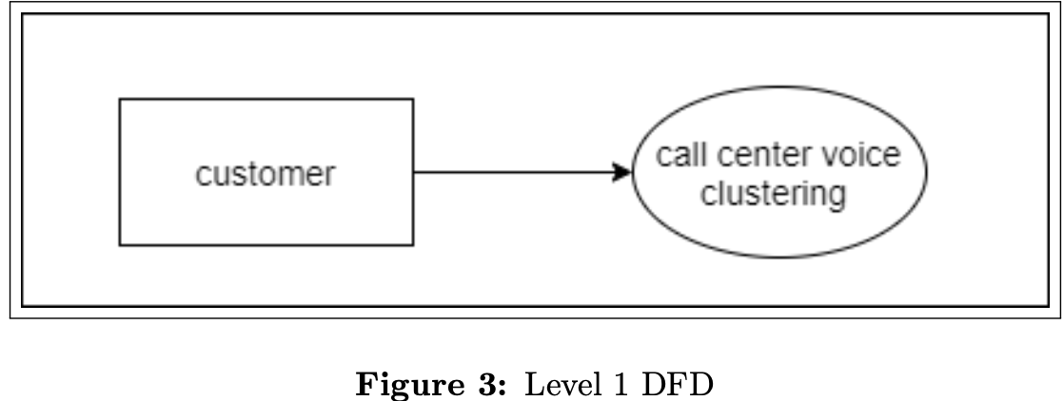
DFD level 1

Slide 16
DFD Level 2
Request speech to text or type request
Stop words elimination
Customer
Classify request types
Final output
Send request to department

Slide 17
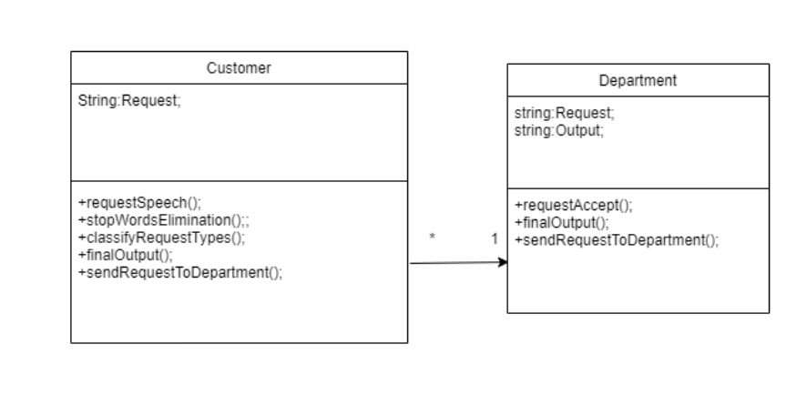
uml
Class diagram

Slide 18
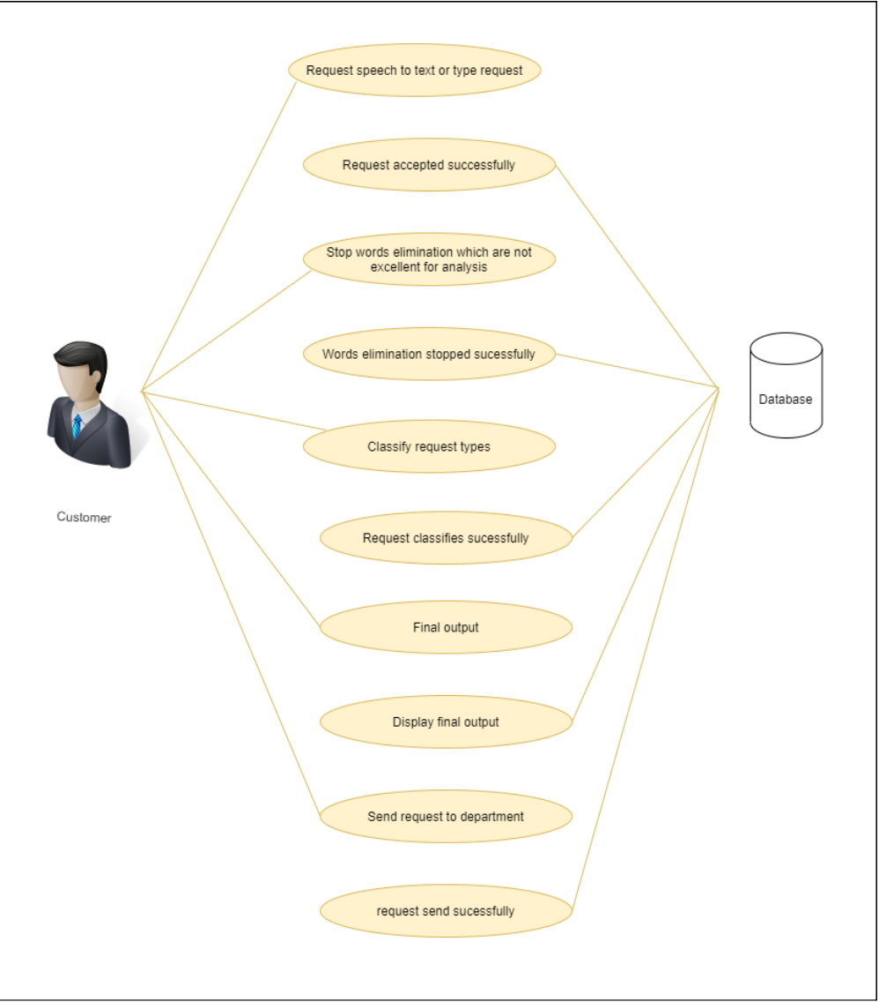
uml
Use case diagram

Slide 19
uml
Customer
activity diagram
Requested speech to text or type request
Stop words elimination that are not excellent for analysis
Classify the request types
Final output
Send request to department

Slide 20
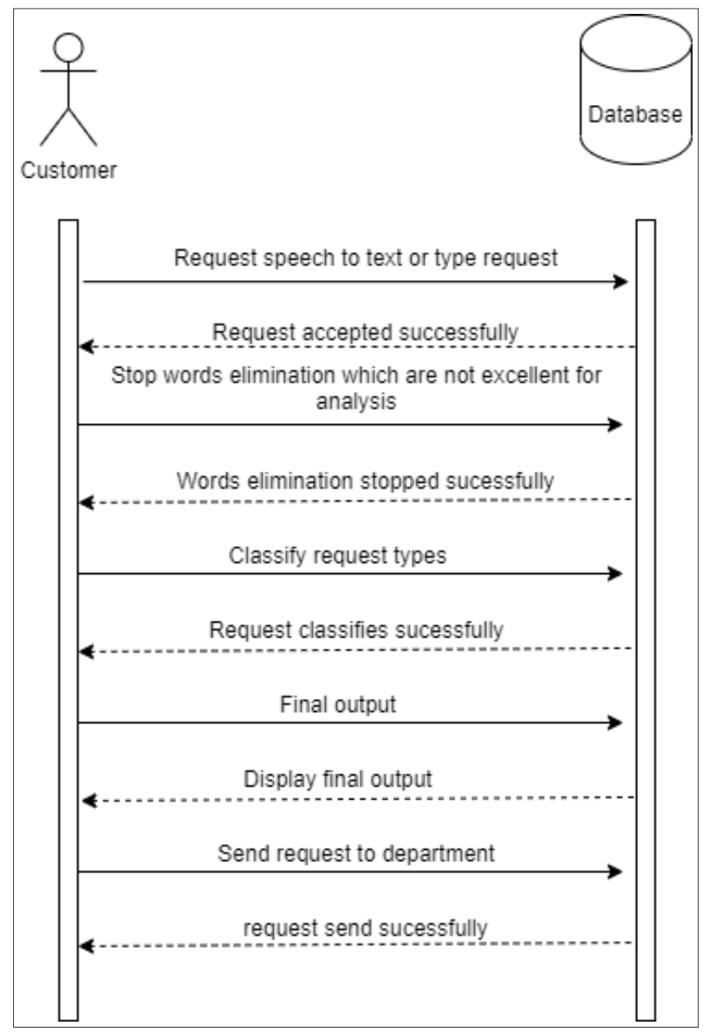
uml
Sequence diagram

Slide 21
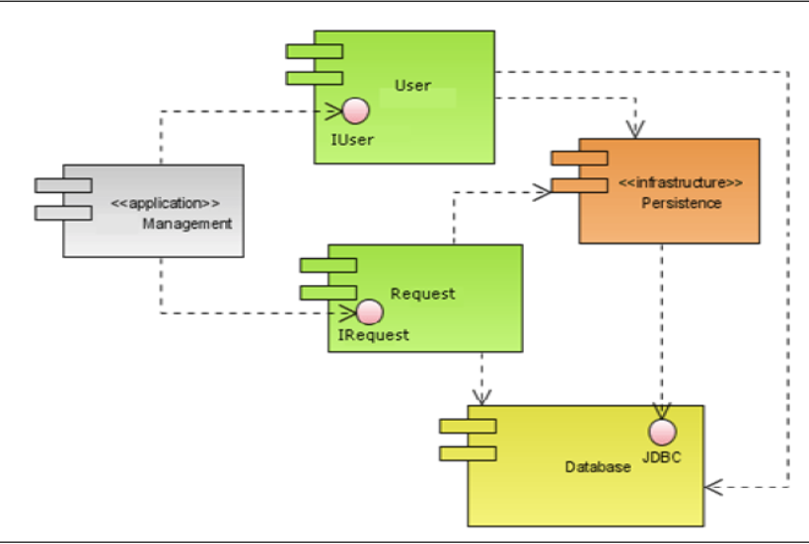
uml
Component diagram

Slide 22
Timeline

Slide 23
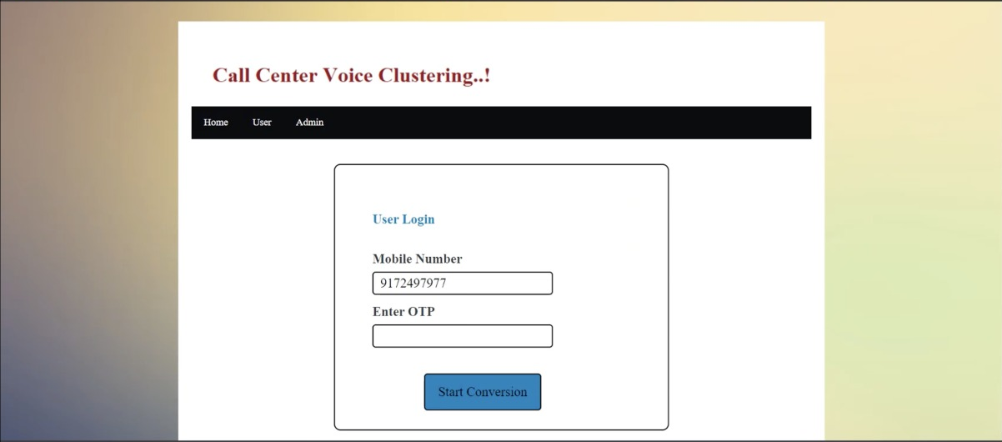
Outputs

Slide 24
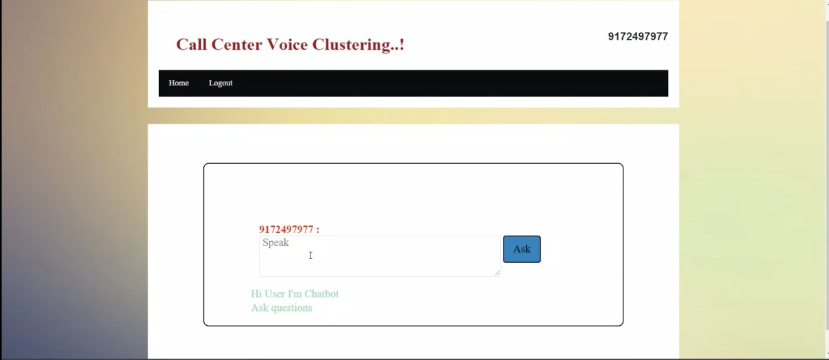
Output

Slide 25
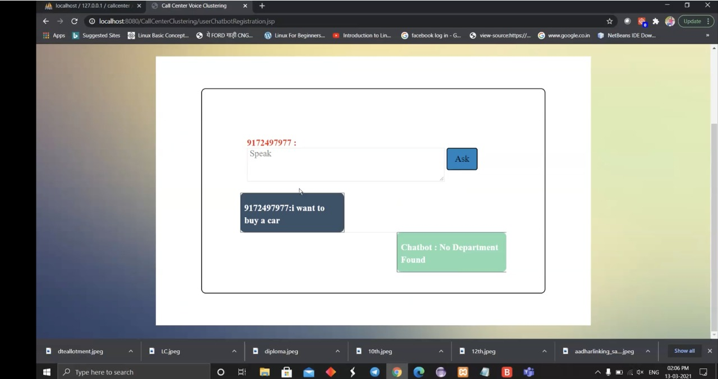
output

Slide 26
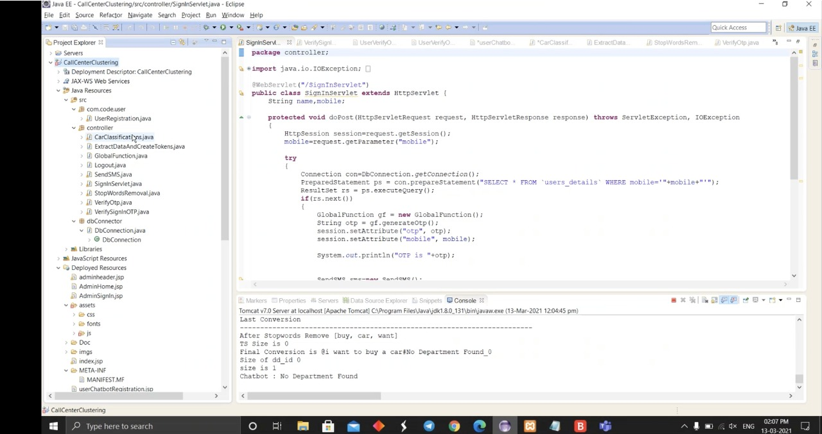
output

Slide 27
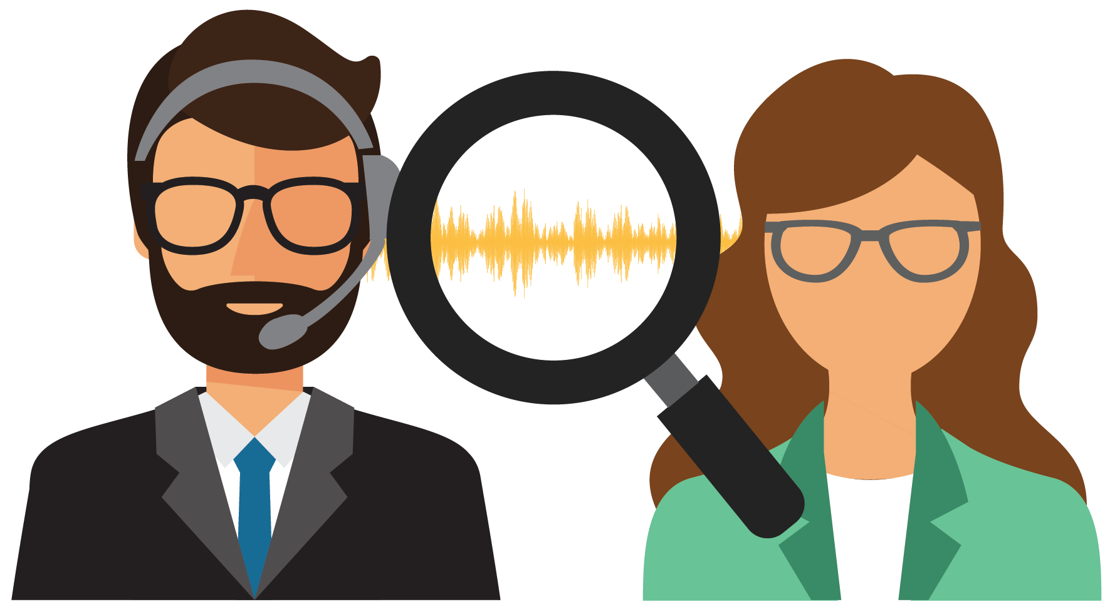
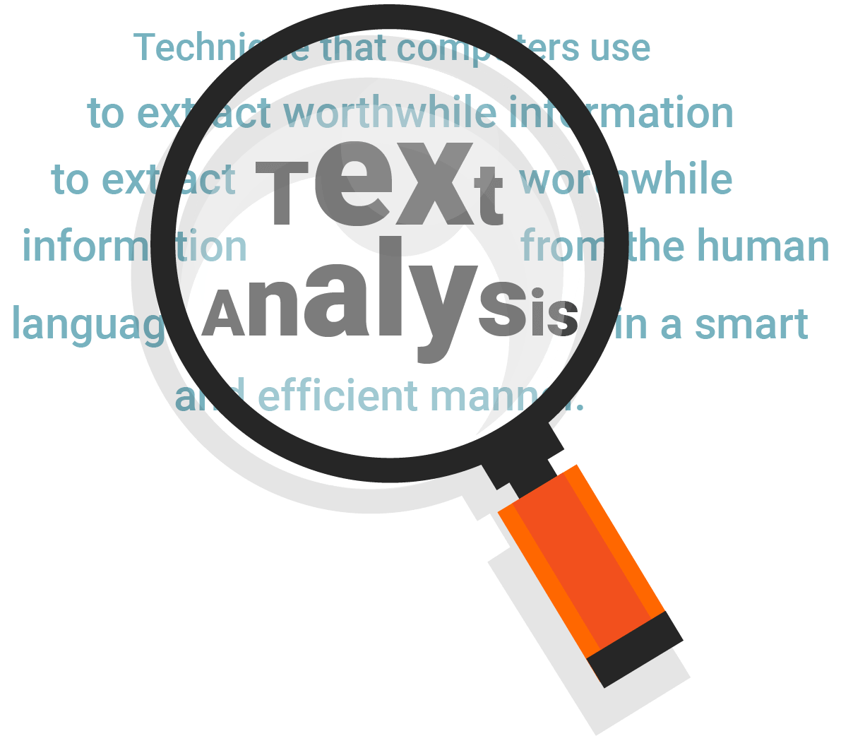
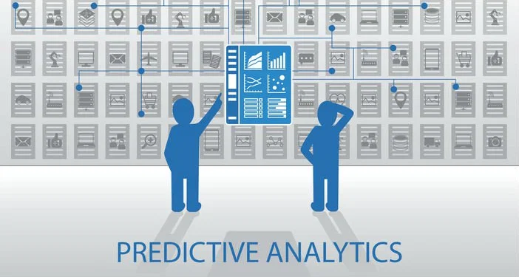
Future applications
Call Center Speech Analytics
Speech Analytics is a fairly new and relatively rare field, but one that many early adopters are finding significant success with.
2. Call Center Text Analytics
Text analytics can review and monitor not only the messages sent to customers, but also the message they are sending to the company. This is vital in seeing any potential issues through the customer lens.
3. Predictive Analytics
The modern predictive analysis engine is an invaluable tool in the call center environment.

Slide 28
Conclusion
So, we have reached to a stage where our output is ready for processing of further application of ML algorithms . The outputs we are currently generating are in form of words ,these words do not have any special symbols or stops words that might create a confusion in further processing of machine learning.

Slide 29
Thank You

